Slide 1
RL Theory

Slide 2
Uniform distributed, independent generalization error, q-learning
Good convergence
Lucky convergene
Bad convergence
Divergence

Slide 3
Summarize the existence algorithms.
Analysis the convergence proof.
Try to generalization the convergence proof to algorithms with nonlinear function approximation and off policy control.

Slide 4
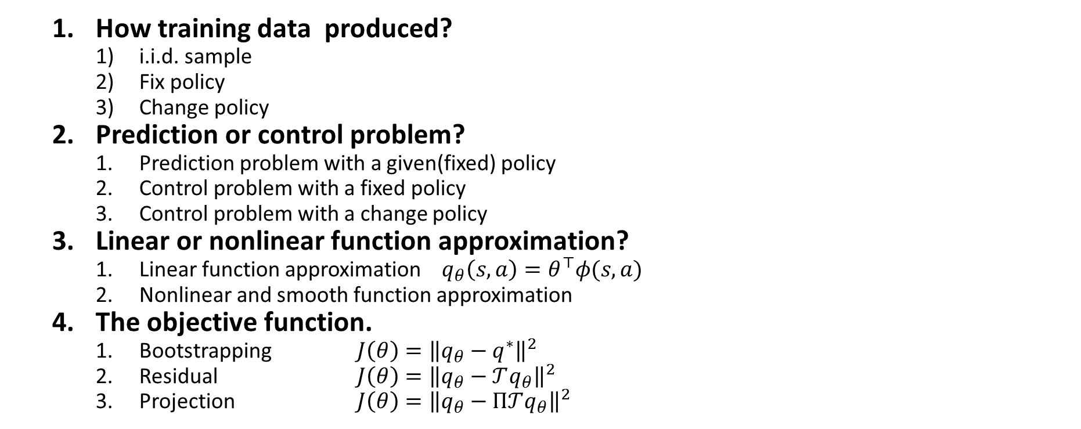
Overview: the key aspect of algorithms
How training data produced?
i.i.d. sample
Fix policy
Change policy
Prediction or control problem?
Prediction problem with a given(fixed) policy
Control problem with a fixed policy
Control problem with a change policy
Linear or nonlinear function approximation?
Linear function approximation $q_{θ}\left(s,a\right)=θ^{⊤}φ(s,a)$
Nonlinear and smooth function approximation
The objective function.
Bootstrapping $J\left(θ\right)={\left\|q_{θ}−q^{∗}\right\|}^{2}$
Residual $J\left(θ\right)={\left\|q_{θ}−𝒯q_{θ}\right\|}^{2}$
Projection $J\left(θ\right)={\left\|q_{θ}−Π𝒯q_{θ}\right\|}^{2}$

Slide 5
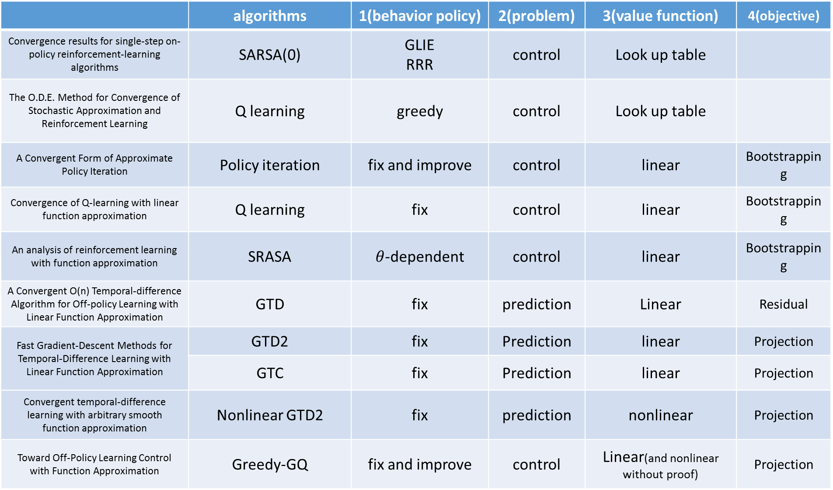
 | algorithms | 1(behavior policy) | 2(problem) | 3(value function) | 4(objective)
Convergence results for single-step on-policy reinforcement-learning algorithms | SARSA(0) | GLIE RRR | control | Look up table
The O.D.E. Method for Convergence of Stochastic Approximation and Reinforcement Learning | Q learning | greedy | control | Look up table
A Convergent Form of Approximate Policy Iteration | Policy iteration | fix and improve | control | linear | Bootstrapping
Convergence of Q-learning with linear function approximation | Q learning | fix | control | linear | Bootstrapping
An analysis of reinforcement learning with function approximation | SRASA | $θ$-dependent | control | linear | Bootstrapping
A Convergent O(n) Temporal-difference Algorithm for Off-policy Learning with Linear Function Approximation | GTD | fix | prediction | Linear | Residual
Fast Gradient-Descent Methods for Temporal-Difference Learning with Linear Function Approximation | GTD2 | fix | Prediction | linear | Projection
 | GTC | fix | Prediction | linear | Projection
Convergent temporal-difference learning with arbitrary smooth function approximation | Nonlinear GTD2 | fix | prediction | nonlinear | Projection
Toward Off-Policy Learning Control with Function Approximation | Greedy-GQ | fix and improve | control | Linear(and nonlinear without proof) | Projection

Slide 6
Update rule
Policy iteration with look up table
Value iteration with look up table
Td(0) with look up table
SARSA with look up table
Q-learning with look up table
Td(0) with linear function approximation
Q-learning with linear function approximation
SARSA with linear function approximation

Slide 7
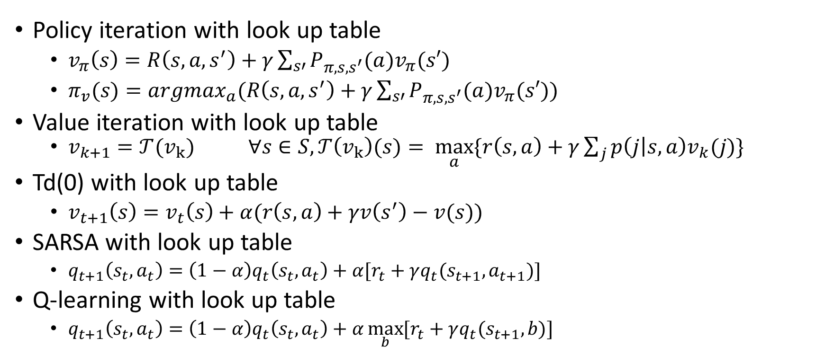
Update rule
Policy iteration with look up table
$v_{π}\left(s\right)=R\left(s,a,s^{′}\right)+γ\sum_{s′}{P_{π,s,s^{′}}(a)v_{π}(s′)}$
$π_{v}(s)=argmax_{a}(R\left(s,a,s^{′}\right)+γ\sum_{s′}{P_{π,s,s^{′}}(a)v_{π}(s′)})$
Value iteration with look up table
$v_{k+1}=𝒯(v_{k})$ $∀s∈S,𝒯\left(v_{k}\right)(s)= \max_{a}{\{r\left(s,a\right)+γ\sum_{j}{p\left(j | s,a\right)v_{k}(j)}\}}$
Td(0) with look up table
$v_{t+1}\left(s\right)=v_{t}\left(s\right)+α(r\left(s,a\right)+γv\left(s^{′}\right)−v(s))$
SARSA with look up table
$q_{t+1}\left(s_{t},a_{t}\right)=\left(1−α\right)q_{t}\left(s_{t},a_{t}\right)+α[r_{t}+γq_{t}(s_{t+1},a_{t+1})]$
Q-learning with look up table
$q_{t+1}\left(s_{t},a_{t}\right)=\left(1−α\right)q_{t}\left(s_{t},a_{t}\right)+α\max_{b}{[r_{t}+γq_{t}(s_{t+1},b)]}$

Slide 8
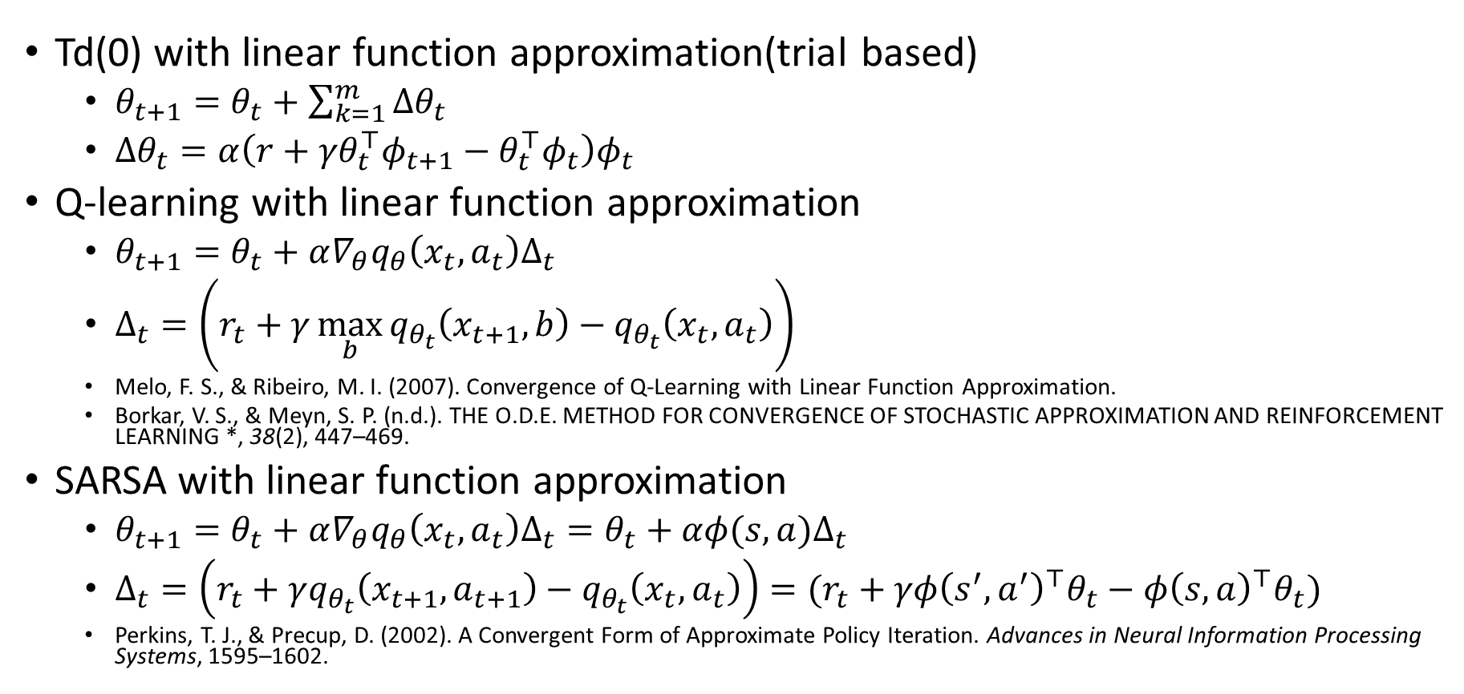
Update rule
Td(0) with linear function approximation(trial based)
$θ_{t+1}=θ_{t}+\sum_{k=1}^{m}{Δθ_{t}}$
$Δθ_{t}=α\left({{r+γθ}_{t}^{⊤}φ}_{t+1}−{θ_{t}^{⊤}φ}_{t}\right)φ_{t}$
Q-learning with linear function approximation
$θ_{t+1}=θ_{t}+α∇_{θ}q_{θ}\left(x_{t},a_{t}\right)Δ_{t}$
$Δ_{t}=\left(r_{t}+γ\max_{b}{q_{θ_{t}}\left(x_{t+1},b\right)}−q_{θ_{t}}\left(x_{t},a_{t}\right)\right)$
Melo, F. S., & Ribeiro, M. I. (2007). Convergence of Q-Learning with Linear Function Approximation.
Borkar, V. S., & Meyn, S. P. (n.d.). THE O.D.E. METHOD FOR CONVERGENCE OF STOCHASTIC APPROXIMATION AND REINFORCEMENT LEARNING *, 38(2), 447–469.
SARSA with linear function approximation
$θ_{t+1}=θ_{t}+α∇_{θ}q_{θ}\left(x_{t},a_{t}\right)Δ_{t}=θ_{t}+αφ(s,a)Δ_{t}$
$Δ_{t}=\left(r_{t}+γq_{θ_{t}}\left(x_{t+1},a_{t+1}\right)−q_{θ_{t}}\left(x_{t},a_{t}\right)\right)=(r_{t}+γφ{\left(s^{′},a^{′}\right)}^{⊤}θ_{t}−φ{\left(s,a\right)}^{⊤}θ_{t})$
Perkins, T. J., & Precup, D. (2002). A Convergent Form of Approximate Policy Iteration. Advances in Neural Information Processing Systems, 1595–1602.

Slide 9
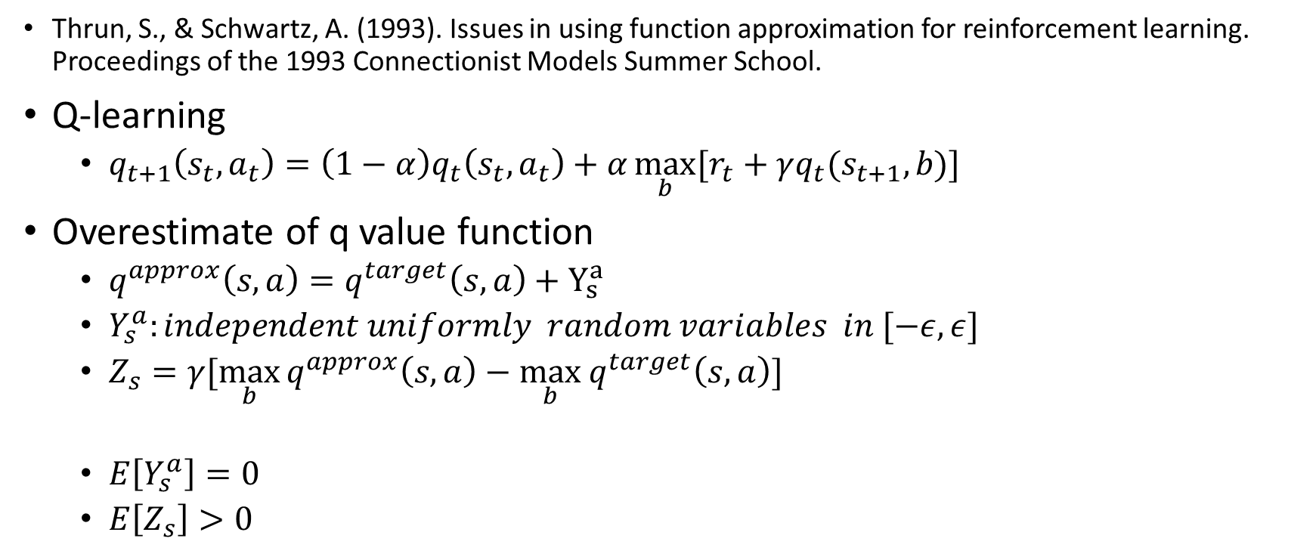
counterexample
Thrun, S., & Schwartz, A. (1993). Issues in using function approximation for reinforcement learning. Proceedings of the 1993 Connectionist Models Summer School.
Q-learning
$q_{t+1}\left(s_{t},a_{t}\right)=\left(1−α\right)q_{t}\left(s_{t},a_{t}\right)+α\max_{b}{[r_{t}+γq_{t}(s_{t+1},b)]}$
Overestimate of q value function
$q^{approx}\left(s,a\right)=q^{target}\left(s,a\right)+Y_{s}^{a}$
$Y_{s}^{a}:independent uniformly random variables in [−ε,ε]$
$Z_{s}=γ[\max_{b}{q^{approx}\left(s,a\right)−\max_{b} q^{target}\left(s,a\right)}]$
$E\left[Y_{s}^{a}\right]=0$
$E\left[Z_{s}\right]>0$

Slide 10
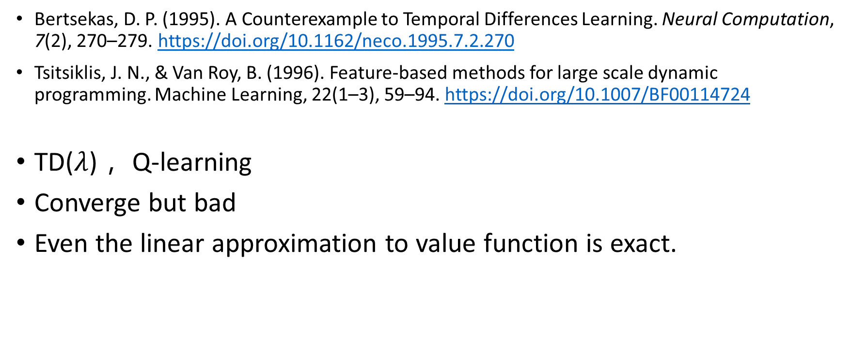
counterexample
Bertsekas, D. P. (1995). A Counterexample to Temporal Differences Learning. Neural Computation, 7(2), 270–279. https://doi.org/10.1162/neco.1995.7.2.270
Tsitsiklis, J. N., & Van Roy, B. (1996). Feature-based methods for large scale dynamic programming. Machine Learning, 22(1–3), 59–94. https://doi.org/10.1007/BF00114724
TD($λ$)， Q-learning
Converge but bad
Even the linear approximation to value function is exact.

Slide 11
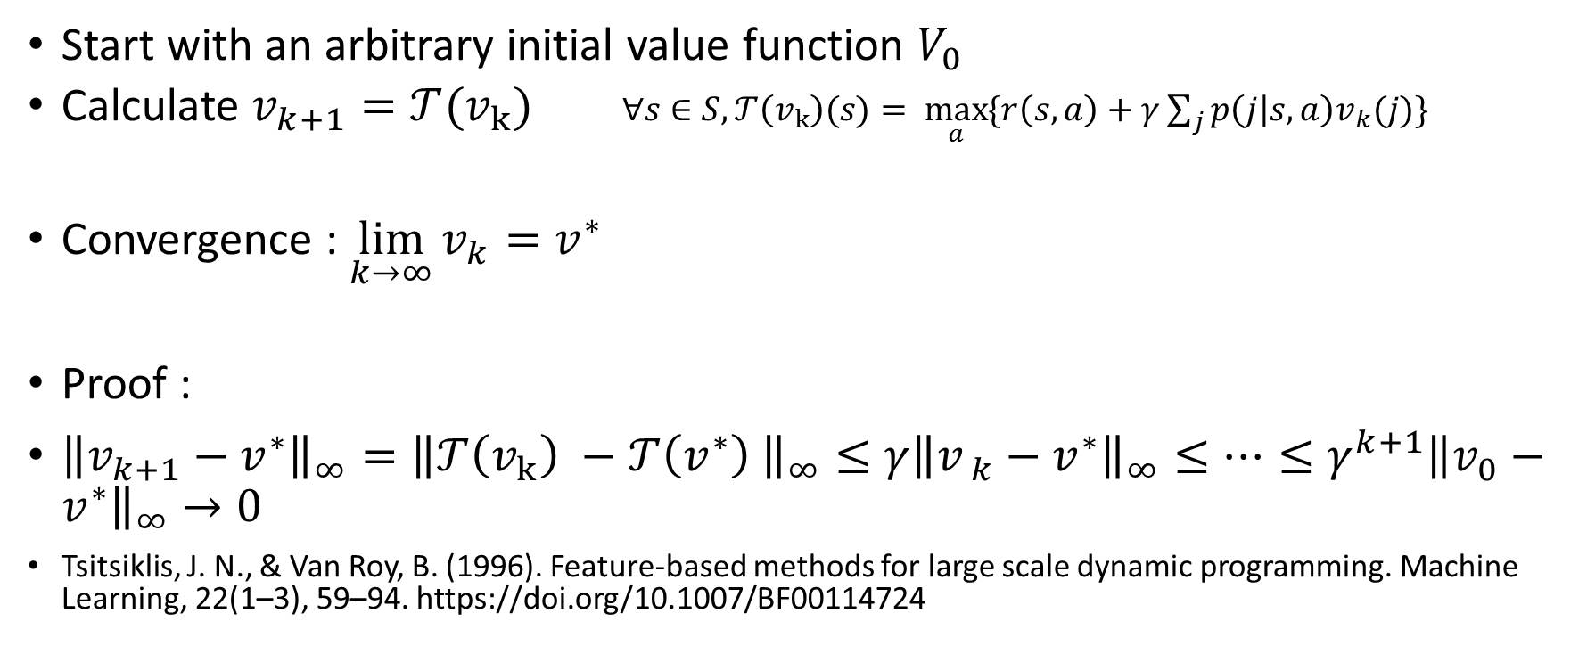
Value iteration with look-up table
Start with an arbitrary initial value function $V_{0}$
Calculate $v_{k+1}=𝒯(v_{k})$ $∀s∈S,𝒯\left(v_{k}\right)(s)= \max_{a}{\{r\left(s,a\right)+γ\sum_{j}{p\left(j | s,a\right)v_{k}(j)}\}}$
Convergence : $\lim_{k→∞}{v_{k}}=v^{∗}$
Proof :
${\left\|v_{k+1}−v^{∗}\right\|}_{∞}={\left\|𝒯\left(v_{k}\right) −𝒯\left(v^{∗}\right) \right\|}_{∞}≤γ{\left\|v_{ k}−v^{∗}\right\|}_{∞}≤…≤γ^{k+1}{\left\|v_{0}−v^{∗}\right\|}_{∞}→0$
Tsitsiklis, J. N., & Van Roy, B. (1996). Feature-based methods for large scale dynamic programming. Machine Learning, 22(1–3), 59–94. https://doi.org/10.1007/BF00114724

Slide 12
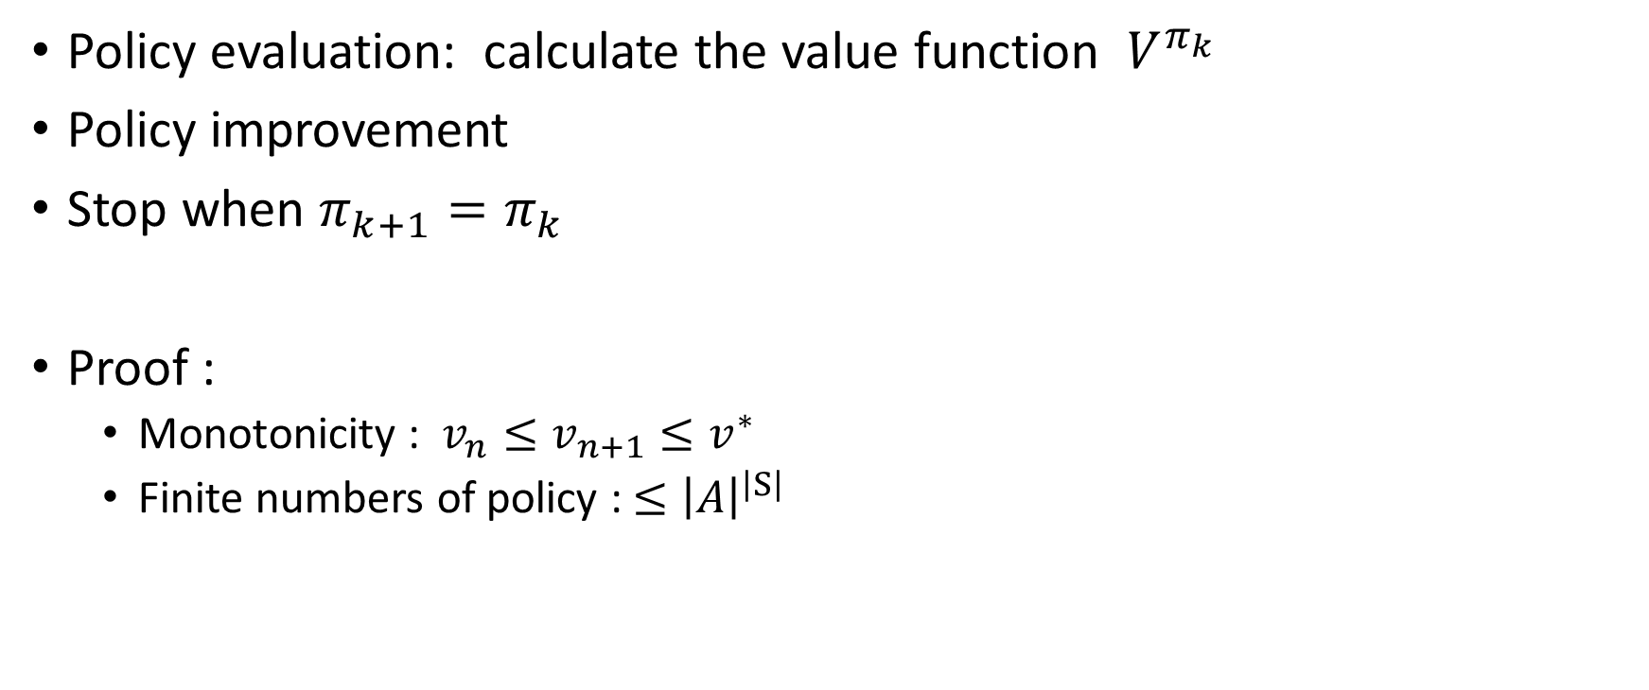
Policy iteration with look-up table
Policy evaluation: calculate the value function $V^{π_{k} }$
Policy improvement
Stop when $π_{k+1}=π_{k}$
Proof :
Monotonicity : $v_{n}≤v_{n+1}≤v^{∗}$
Finite numbers of policy : ${≤\left|A\right|}^{\left|S\right|}$

Slide 13
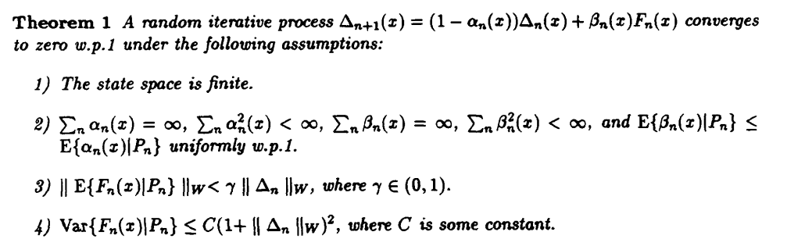
Q-learning with look up table
Borkar, V. S., & Meyn, S. P. (2000). The O.D.E. Method for Convergence of Stochastic Approximation and Reinforcement Learning. SIAM Journal on Control and Optimization, 38(2), 447–469. https://doi.org/10.1137/S0363012997331639
Jaakkola, T., Jordan, M. I., & Singh, S. P. (1994). On the Convergence of Stochastic Iterative Dynamic Programming Algorithms. Neural Computation. https://doi.org/10.1162/neco.1994.6.6.1185

Slide 14
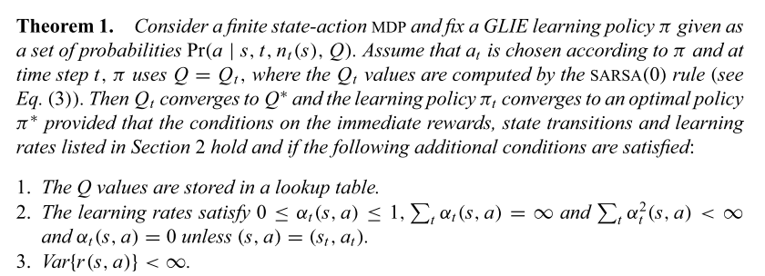
SARSA with look up table
Singh, S., Jaakkola, T., Littman, M. L., & Szepesvári, C. (2000). Convergence results for single-step on-policy reinforcement-learning algorithms. Machine Learning, 38(3), 287–308. https://doi.org/10.1023/A:1007678930559

Slide 15
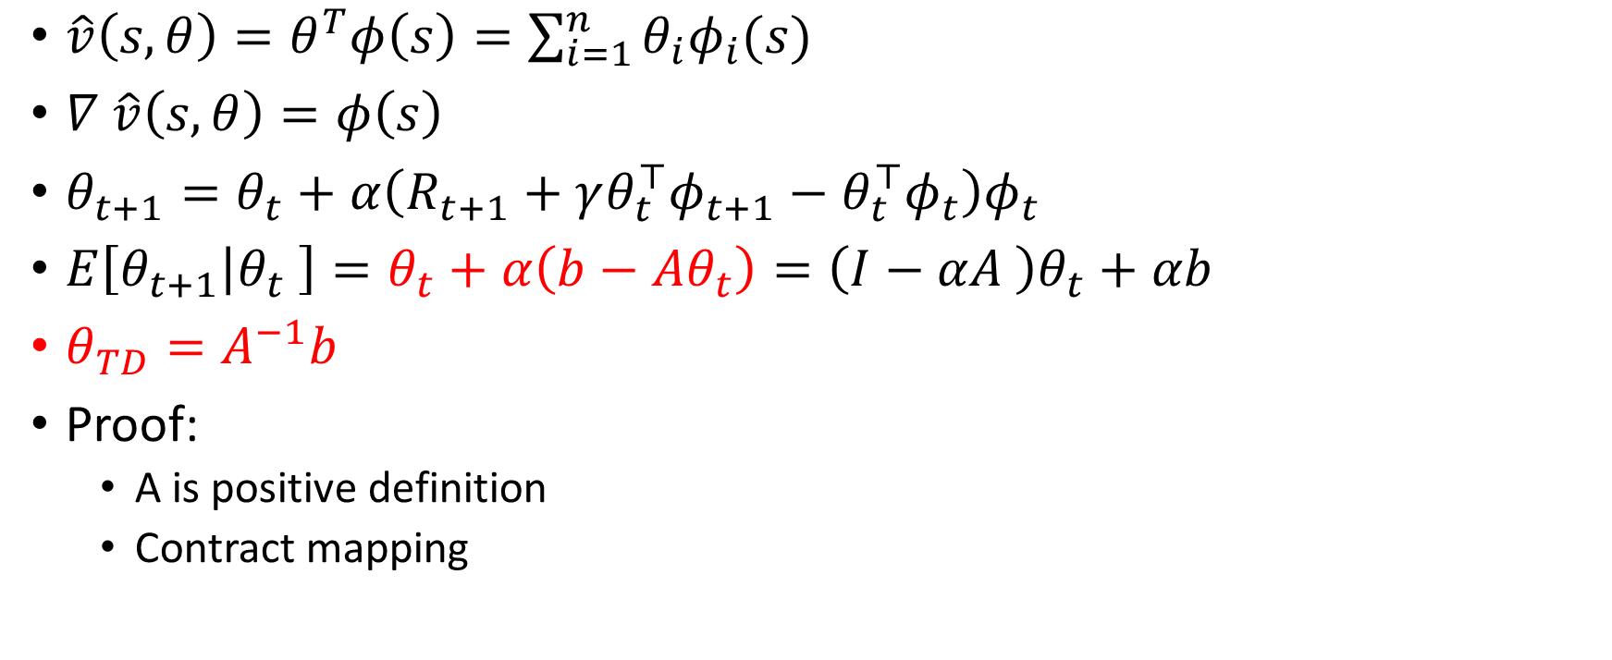
TD(0) with linear approximation(on policy)
$\hat{v}\left(s,θ\right)=θ^{T}φ\left(s\right)=\sum_{i=1}^{n}{θ_{i}φ_{i}(s)}$
$∇ \hat{v}\left(s,θ\right)=φ\left(s\right)$
$θ_{t+1}=θ_{t}+α\left(R_{t+1}+γθ_{t}^{⊤}φ_{t+1}−θ_{t}^{⊤}φ_{t}\right)φ_{t}$
$E\left[θ_{t+1} | θ_{t} \right]=θ_{t}+α\left(b−Aθ_{t}\right)=\left(I−αA \right)θ_{t}+αb$
$θ_{TD}=A^{−1}b$
Proof:
A is positive definition
Contract mapping

Slide 16
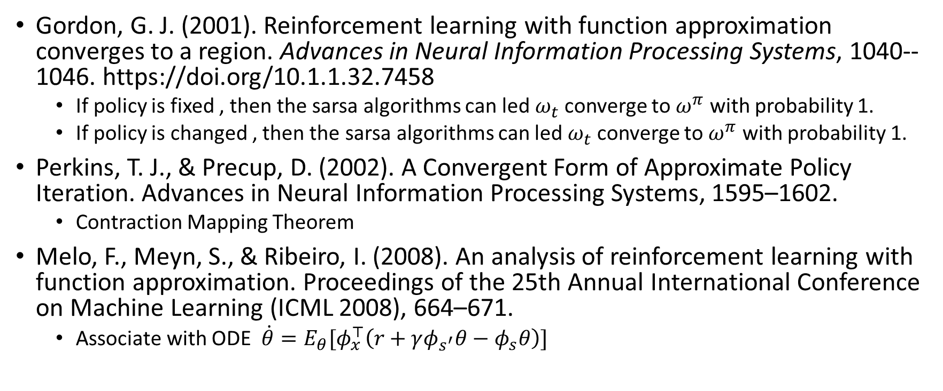
SARSA with linear approximation(on policy)
Gordon, G. J. (2001). Reinforcement learning with function approximation converges to a region. Advances in Neural Information Processing Systems, 1040--1046. https://doi.org/10.1.1.32.7458
If policy is fixed , then the sarsa algorithms can led $ω_{t}$converge to $ω^{π}$ with probability 1.
If policy is changed , then the sarsa algorithms can led $ω_{t}$converge to $ω^{π}$ with probability 1.
Perkins, T. J., & Precup, D. (2002). A Convergent Form of Approximate Policy Iteration. Advances in Neural Information Processing Systems, 1595–1602.
Contraction Mapping Theorem
Melo, F., Meyn, S., & Ribeiro, I. (2008). An analysis of reinforcement learning with function approximation. Proceedings of the 25th Annual International Conference on Machine Learning (ICML 2008), 664–671.
Associate with ODE $\dot{θ}=E_{θ}[φ_{x}^{⊤}\left(r+γφ_{s^{′}}θ−φ_{s}θ\right)]$

Slide 17
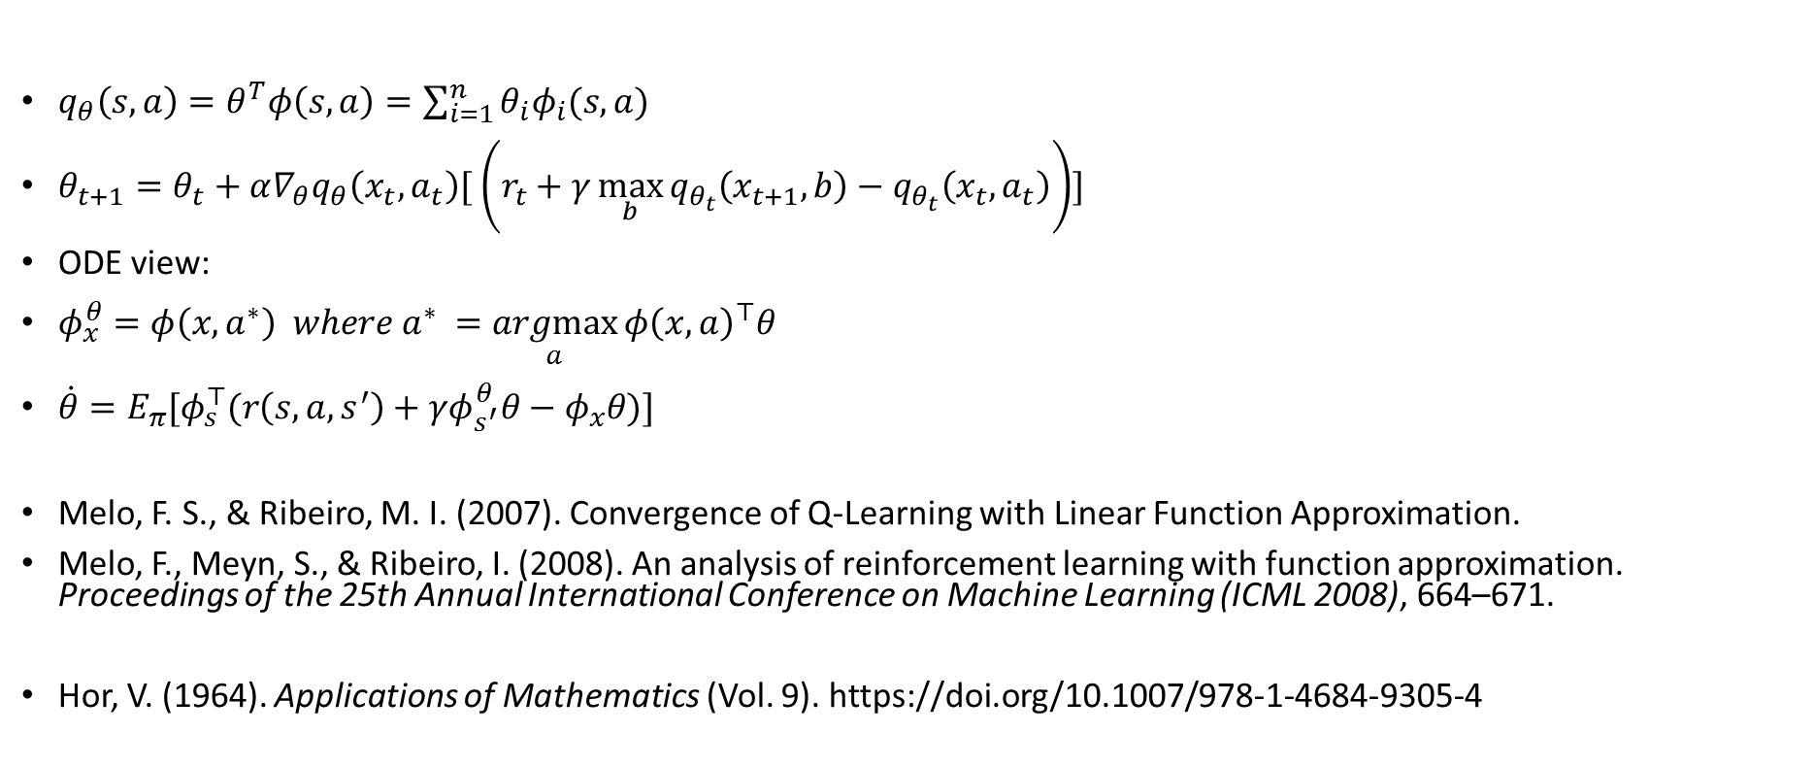
Q learning with linear approximation(off policy)
$q_{θ}\left(s,a\right)=θ^{T}φ\left(s,a\right)=\sum_{i=1}^{n}{θ_{i}φ_{i}(s,a)}$
$θ_{t+1}=θ_{t}+α∇_{θ}q_{θ}\left(x_{t},a_{t}\right)[ \left(r_{t}+γ\max_{b}{q_{θ_{t}}\left(x_{t+1},b\right)}−q_{θ_{t}}\left(x_{t},a_{t}\right)\right)]$
ODE view:
$φ_{x}^{θ}=φ\left(x,a^{∗}\right) where a^{∗} =\underset{a}{argmax}{φ{\left(x,a\right)}^{⊤}θ }$
$\dot{θ}=E_{π}[φ_{s}^{⊤}(r\left(s,a,s^{′}\right)+γφ_{s^{′}}^{θ}θ−φ_{x}θ)]$
Melo, F. S., & Ribeiro, M. I. (2007). Convergence of Q-Learning with Linear Function Approximation.
Melo, F., Meyn, S., & Ribeiro, I. (2008). An analysis of reinforcement learning with function approximation. Proceedings of the 25th Annual International Conference on Machine Learning (ICML 2008), 664–671.
Hor, V. (1964). Applications of Mathematics (Vol. 9). https://doi.org/10.1007/978-1-4684-9305-4

Slide 18
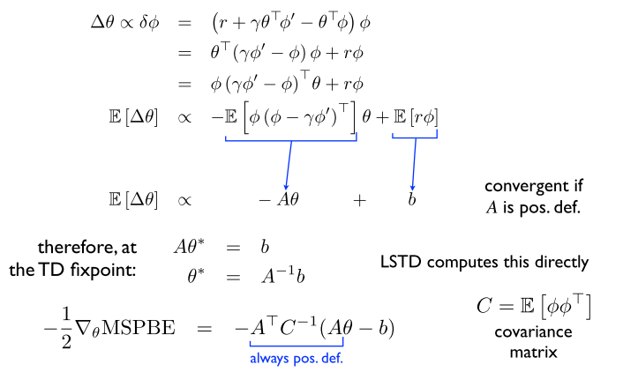
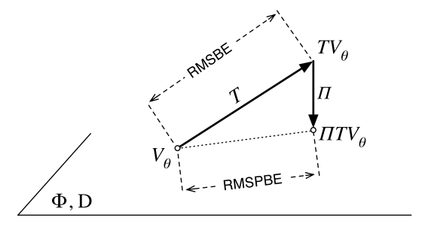

Some new proposed algorithms
GTD
$δ=r+γθ^{⊤}φ_{s′}−θ^{⊤}φ_{s}$
$J\left(θ\right)=E{\left[δφ\right]}^{⊤}E[δφ]$
GTD2
$J\left(θ\right)={\left\|v_{θ}−ΠTv_{θ}\right\|}^{2}$
Maei, H., Szepesvari, C., Bhathnagar, S., Silver, D., Precup, D., & Sutton, R. (2009). Convergent temporal-difference learning with arbitrary smooth function approximation. Advances in Neural Information Processing Systems

Slide 20

Upper bound of approximate optimal value functions
$\left|v^{∗}\left(x\right)−\hat{v}\left(x\right)\right|≤ε$
$v^{∗}\left(x\right)−v_{\hat{v}}\left(x\right)≤\frac{2γε}{1−γ}$

Slide 22
Is the algorithm convergence ?
The algorithms convergence to where?
How fast the algorithms converge?

Slide 23
 |  | 1 | 2 | 3
Convergence results for single-step on-policy reinforcement-learning algorithms | SARSA(0) | GLIE RRR | control | Look up table
The O.D.E. Method for Convergence of Stochastic Approximation and Reinforcement Learning | Q learning | greedy | control | Look up table
An analysis of reinforcement learning with function approximation | SARSA |  |  | linear
 | Q learning | fix
A Convergent Form of Approximate Policy Iteration | Policy iteration | fix and improve | control | linear | Bootstrapping

